Slide 1
Intelligent Hand-eye Expert
RVC Series
3D Area Scanner
RVC-I series
www.rvbust.com

Slide 2
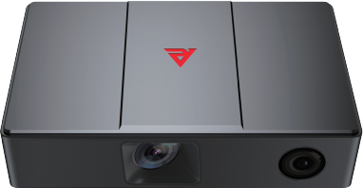
Professional 3D area scanner built for craftsmanship
Intelligent Hand-eye Expert
RVC-I540
Ultra-high-precision
3D Area Scanner
RVC-I540 ultra-high precision 3D area scanner, equipped with 5-megapixel high-definition lens, Z-axis single point repetition accuracy can reach up to micron level. It has excellent imaging effect on highly reflective workpieces, and is applied to test the products of precision 3C, the gaps, height difference and morphology detection of electronic components, and other application scenarios.
Aviation aluminum integrated fuselage
Provides comprehensive protection
Waterproof level greatly improved
Dust proof level greatly improved
Passed professional vibration test
USB 3.0 data transmission
Integrated Body
stable and solid
Fan-free heat dissipation Design
Weight loss, noise reduction, smaller volume
High environmental resistance performance fuselage
Aviation aluminum alloy shell
Equipped with high-resolution lens
High brightness 3D Blu-ray module Stabilization of light output
To achieve a stable and reliable scanning
Reduce the image noise of point cloud
IP 65 class protection
www.rvbust.com
400 - 0419 - 900
sales@rvbust.com

Slide 3
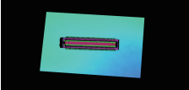
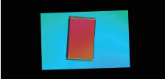
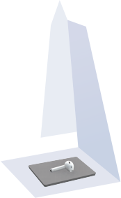
Professional 3D area scanner built for craftsmanship
Intelligent Hand-eye Expert
Core Advantages
Ultra high precision
Self-developed machine vision high precision calibration algorithm, single point repetition accuracy up to micron level.
Stable and reliable
With IP65 protection level and a number of tests, it can operate stably in a harsh environment.
Anti-interference
HDR dynamic point cloud synthesis technology to effectively handle the presence of both black and bright white at the same time.
Point cloud display
Headphone appearance gap detection
point cloud
The connector detects the point cloud
IC component detection
point cloud
Product reference data
model | RVC-I540
Minimum shooting time (sec / frame) | 1.53
Resolution (MP) | 5
Operating distance range (mm) | 120~130
Near field of view (FOV) (mm) | 39*26 @ 120
Far field of view (FOV) (mm) | 42*27 @ 130
XY directional resolution (mm) | 0.0149~0.0151
Z-axis single-point repetition accuracy (mm) | 0.0006~0.0015
Repeat accuracy of the Z-axis region (mm) | 0.00003~0.00005
illuminant source | blue LED
Communication interface | USB3.0
Camera weight (kg) | 1.4
Camera size (mm) | 220*135*57
Operating voltage / current | DC 24V/3.75A
Levels of protection | IP65
Operating temperature (°C) | 0~45
Operating Humidity (% RH) | 20~80 (no condensation)
Standard fitting | Power supply adapter, power supply cord, data cable
Whether the third-party development is supported | yes
Supported development language | C/C++/C#/Python
Supported development platform | Linux/Windows
Adapt to the third-party software library | Halcon/OpenCV/Open3D/PC L/VisionPro
120mm
130mm
26mm
39mm
27mm
42mm
www.rvbust.com
400 - 0419 - 900
sales@rvbust.com

Slide 4
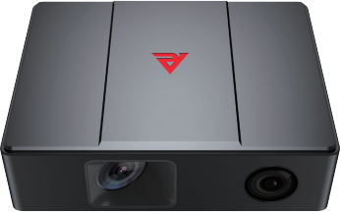
Professional 3D area scanner built for craftsmanship
Intelligent Hand-eye Expert
RVC-I3120
Micrometer-grade
3D Area Scanner
RVC-I3120 micron level 3D area scanner, it has ultra high precision micron level, shooting fast, prevent refle-ction. It is capable of detecting localized glue lines, screws, mountings, defects, etc. on various objects. Such as computer motherboards and cell phone frames. It can output the high-precision 3D point cloud data rapidly to determine quickly and accurately whether the product is qualified. It can improve the quality detection level and detection efficiency greatly.
Aviation aluminum integrated fuselage
Provides comprehensive protection
Waterproof level greatly improved
Dust proof level greatly improved
Passed professional vibration test
USB 3.0 data transmission
Integrated Body
stable and solid
Fan-free heat dissipation Design
Weight loss, noise reduction, smaller volume
Equipped with high-resolution lens
High environmental resistance
performance fuselage
High brightness 3D Blu-ray module Stabilization of light output
To achieve a stable and reliable scanning
Reduce the image noise of point cloud
Aviation aluminum alloy shell
IP 65 class protection
www.rvbust.com
400 - 0419 - 900
sales@rvbust.com

Slide 5
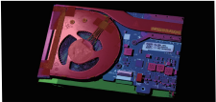
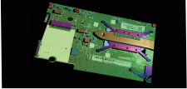
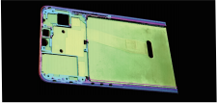
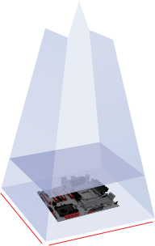
Professional 3D area scanner built for craftsmanship
Intelligent Hand-eye Expert
Core advantage
Ultra high precision
Self-developed machine vision high precision calibration algorithm, single point repetition accuracy up to 1.37 μ m.
Fast shooting speed
The fastest can achieve the shooting speed of 0.67s / frame, effectively improve the detection efficiency.
Anti-interference
HDR dynamic point cloud synthesis technology to effectively handle the presence of both black and bright white at the same time.
Point cloud display
Computer mainboard detects
point cloud
Circuit board screw detection
point cloud
Mobile phone midboard detection
point cloud
Product reference data
model | RVC-I3120
Minimum shooting time (sec / frame) | 0.67
Resolution (MP) | 3.2
Operating distance range (mm) | 130~160
Near Field of View (FOV) (mm) | 107*62 @ 130
Far Field of View (FOV) (mm) | 127*74 @ 160
XY direction resolution (mm) | 0.052~0.059
Z-axis single-point repetition accuracy (mm) | 0.00137~0.00233
Repeat accuracy of the Z-axis region (mm) | 0.00048~0.00083
illuminant source | blue LED
Communication interface | USB3.0
Camera weight (kg) | 1
Camera size (mm) | 180*135*57
Operating voltage / current | DC 24V/3.75A
Levels of protection | IP65
Operating temperature (°C) | 0~45
Operating Humidity (% RH) | 20~80 (no condensation)
Standard fitting | Power supply adapter, power supply cord, data cable
Whether the third-party development is supported | yes
Supported development language | C/C++/C#/Python
Supported development platform | Linux/Win dows
Adapt to the third-party software library | Halcon/OpenCV/Open3D/PCL /VisionPro
130mm
160mm
62mm
107mm
74mm
127mm
www.rvbust.com
400 - 0419 - 900
sales@rvbust.com

Slide 6
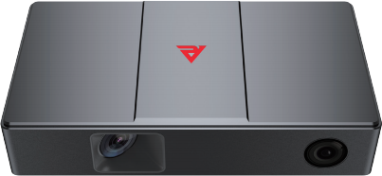
Professional 3D area scanner built for craftsmanship
Intelligent Hand-eye Expert
RVC-I360
Micrometer-grade
3D Area Scanner
RVC-I360 micron level 3D area scanner, with ultra-high precision in the nanometer range can shoot fast and prevent reflection. It can detect flatness, height, segment difference, hole position, defects, etc. on PCBA boards, Li-ion batteries, earphones, cell phones, and other objects with complex structures, tiny details, and different shapes. It can quickly output high-quality 3D point cloud data with complete structure and rich details to meet the inspection and measurement needs of 3C, electronic components, automotive manufac-turing and other high-precision industries.
Aviation aluminum integrated fuselage Provides comprehensive protection
Waterproof level greatly improved
Dust proof level greatly improved
Passed professional vibration test
USB 3.0 data transmission
Integrated Body
stable and solid
—————
Fan-free heat dissipation Design
Weight loss, noise reduction, smaller volume
High environmental resistance
performance fuselage
High brightness 3D Blu-ray module Stabilization of light output
To achieve a stable and reliable scanning
Equipped with high-resolution lens
Aviation aluminum alloy shell
Reduce the image noise of point cloud
IP 65 class protection
www.rvbust.com
400 - 0419 - 900
sales@rvbust.com

Slide 7
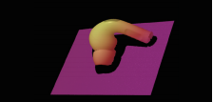
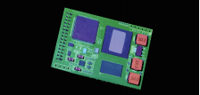
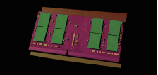
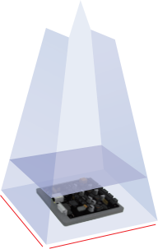
Professional 3D area scanner built for craftsmanship
Intelligent Hand-eye Expert
Core advantage
Ultra high precision
Self-developed machine vision high precision calibration algorithm, single point repetition accuracy up to submicron level.
Fast shooting speed
The fastest can achieve the shooting speed of 0.72s / frame, effectively improve the detection efficiency.
Anti-interference
HDR dynamic point cloud synthesis technology to effectively handle the presence of both black and bright white at the same time.
Point cloud display
Headphone detection point cloud
The PCBA board detects the point cloud
The PCBA board detects the point cloud
Product reference data
model | RVC-I360
Minimum shooting time (sec / frame) | 0.72
Resolution(MP) | 3.2
Operating distance range (mm) | 190~220
Near Field of View (FOV) (mm) | 52*38 @ 190
Far Field of View (FOV) (mm) | 60*42 @ 220
XY direction resolution (mm) | 0.026~0.027
Z-axis single-point repetition accuracy (mm) | 0.0009~0.0022
Repeat accuracy of the Z-axis region (mm) | 0.0002~0.0004
illuminant source | blue LED
Communication interface | USB3.0
Camera weight (kg) | 1.5
Camera size (mm) | 250*135*57
Operating voltage / current | DC 24V/3.75A
Levels of protection | IP65
Operating temperature (°C) | 0~45
Operating Humidity (% RH) | 20~80 (no condensation)
Standard fitting | Power supply adapter, power supply cord, data cable
Whether the third-party development is supported | yes
Supported development language | C/C++/C#/Python
Supported development platform | Linux/Win dows
Adapt to the third-party software library | Halcon/OpenCV/Open3D/PCL /VisionPro
190mm
220mm
38mm
52mm
42mm
60mm
www.rvbust.com
400 - 0419 - 900
sales@rvbust.com

Slide 8
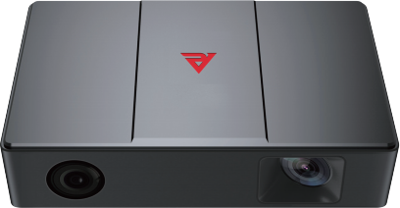
Professional 3D area scanner built for craftsmanship
Intelligent Hand-eye Expert
RVC-I5140
Ultra-high-precision
3D Area Scanner
RVC-I5140 ultra-high precision 3D area scanner, equipped with 5 megapixel HD lens. It supports 2D + 3D imaging. The scanner's Z-axis single-point repeatability can reach up to micron level, which can be applied to the defect detection of plastic parts, the height difference of the screws of PCBA, colloid detection and other application scenarios.
Aviation aluminum integrated fuselage Provides comprehensive protection
Waterproof level greatly improved
Dust proof level greatly improved
Passed professional vibration test
Gigabit Ethernet port data transfer
Integrated Body
stable and solid
Fan-free heat dissipation Design
Weight loss, noise reduction, smaller volume
High brightness 3D Blu-ray module Stabilization of light output
To achieve a stable and reliable scanning
Equipped with high-resolution lens
High environmental resistance
performance fuselage
Reduce the image noise of point cloud
Aviation aluminum alloy shell
IP 65 class protection
www.rvbust.com
400 - 0419 - 900
sales@rvbust.com

Slide 9
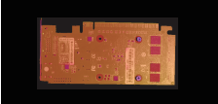
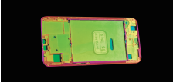
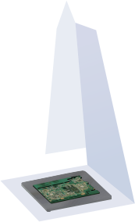
Professional 3D area scanner built for craftsmanship
Intelligent Hand-eye Expert
Core advantage
Ultra high precision
Self-developed machine vision high-precision calibration algorithm, single point repeat accuracy as high as 6 μ m.
2D + 3D imaging
Anti-interference
HDR dynamic point cloud synthesis technology to effectively handle the presence of both black and bright white.
2D images and 3D point clouds can be output at one time for facilitate detection of applications.
Point cloud display
PCBA board screw hole detection
point cloud
Cell phone center frame hole detection point cloud
Structural component hole detection
point cloud
Product reference data
model | RVC-I5140
Minimum shooting time (sec / frame) | 2.1
Resolution (MP) | 5
Operating distance range (mm) | 280~320
Near Field of View (FOV) (mm) | 158*129 @ 280
Far Field of View (FOV) (mm) | 179*143 @ 320
XY direction resolution (mm) | 0.065-0.073
Z-axis single-point repetition accuracy (mm) | 0.0069~0.0103
Repeat accuracy of the Z-axis region (mm) | 0.0005~0.0011
illuminant source | blue LED
Communication interface | Gigabit Ethernet
Camera weight (kg) | 1.5
Camera size (mm) | 220*135*57
Operating voltage / current | DC 24V/3.75A
Levels of protection | IP65
Operating temperature (°C) | 0~45
Operating Humidity (RH) | 20~80% (no condensation)
Standard fitting | Power supply adapter, power supply cord, data cable
Whether the third-party development is supported | yes
Supported development language | C/C++/C#/Python
Supported development platform | Linux/Windows
Adapt to the third-party software library | Halcon/OpenCV/Open3D/PCL/VisionPro
280mm
320mm
129mm
158mm
143mm
179mm
www.rvbust.com
400 - 0419 - 900
sales@rvbust.com

Slide 10
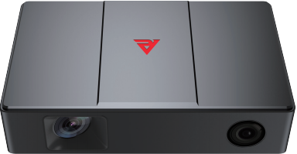
Professional 3D area scanner built for craftsmanship
Intelligent Hand-eye Expert
RVC-I3240
High-precision
3D Area Scanner
RVC-I3240 high-precision 3D area scanner, shoots with high precision, high speed, anti-reflective. It can be completely imaging of metal, plastic and other objects, output of high-quality 3D point cloud data efficiently, for glue line, foreign objects, defects, and other detection items. Widely used in 3C digital, automobile, home appliances and other machine assembly scenarios.
Aviation aluminum integrated fuselage Provides comprehensive protection
Waterproof level greatly improved
Dust proof level greatly improved
Passed professional vibration test
USB 3.0 data transmission
Integrated Body
stable and solid
Fan-free heat dissipation Design
Weight loss, noise reduction, smaller volume
High brightness 3D Blu-ray module Stabilization of light output
To achieve a stable and reliable scanning
Equipped with high-resolution lens
High environmental resistance
performance fuselage
Reduce the image noise of point cloud
Aviation aluminum alloy shell
IP 65 class protection
www.rvbust.com
400 - 0419 - 900
sales@rvbust.com

Slide 11
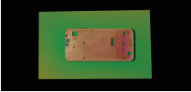
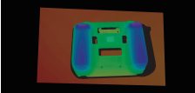
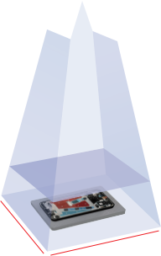
Professional 3D area scanner built for craftsmanship
Intelligent Hand-eye Expert
Core advantage
High-accuracy
Self-developed machine vision high-precision calibration algorithm, single point repeat accuracy as high as 4 μ m.
Fast shooting fast
The fastest can achieve 0.8s / frame shooting speed, effectively improve the efficiency of industrial detection.
Anti-interference
HDR dynamic point cloud synthesis technology to effectively handle the presence of both black and bright white at the same time.
Point cloud display
The mobile phone in the box detection
point cloud
The plastic remote control shell detects the
point cloud
Lithium battery surface defect detection
point cloud
Product reference data
model | RVC-I3240
Minimum shooting time (sec / frame) | 0.8
Resolution (MP) | 3.2
Operating distance range (mm) | 300~400
Near Field of View (FOV) (mm) | 217*137 @ 300
Far Field of View (FOV) (mm) | 257*183 @ 400
XY direction resolution (mm) | 0.103~0.134
Z-axis single-point repetition accuracy (mm) | 0.004~0.006
Repeat accuracy of the Z-axis region (mm) | 0.001~0.003
illuminant source | blue LED
Communication interface | USB3.0
Camera weight (kg) | 1.5
Camera size (mm) | 220*135*57
Operating voltage / current | DC 24V/3.75A
Levels of protection | IP65
Operating temperature (°C) | 0~45
Operating Humidity (% RH) | 20~80 (no condensation)
Standard fitting | Power supply adapter, power supply cord, data cable
Whether the third-party development is supported | yes
Supported development language | C/C++/C#/Python
Supported development platform | Linux/Win dows
Adapt to the third-party software library | Halcon/OpenCV/Open3D/PCL /VisionPro
300mm
400mm
137mm
217mm
183mm
257mm
www.rvbust.com
400 - 0419 - 900
sales@rvbust.com

Slide 12
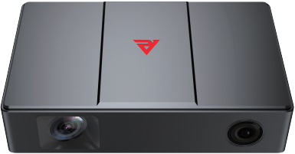
Professional 3D area scanner built for craftsmanship
Intelligent Hand-eye Expert
RVC-I5180
Micrometer-grade
3D Area Scanner
RVC-I5180 micron-level 3D area scanner, equipped with 5 megapixel high-definition lens, with micron-level ultra-high precision, 180mm depth of field. It can be used to detect the size, spacing, hole position, defects, flatness and other inspection items of all kinds of workpieces with different materials and sizes. This scanner is suitable for automotive parts and components mounting holes position and size inspection, glue line inspection, concrete block flatness inspection and other scenarios.
、
、
Aviation aluminum integrated fuselage provides comprehensive protection
Waterproof level greatly improved
Dust proof level greatly improved
Passed professional vibration test
Gigabit Ethernet port data transfer
Integrated Body
stable and solid
Fan-free heat dissipation Design
Weight loss, noise reduction, smaller volume
High brightness 3D Blu-ray module Stabilization of light output
To achieve a stable and reliable scanning
Equipped with high-resolution lens
High environmental resistance
performance fuselage
Reduce the image noise of point cloud
Aviation aluminum alloy shell
IP 65 class protection
www.rvbust.com
400 - 0419 - 900
sales@rvbust.com

Slide 13
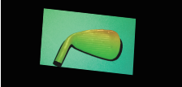
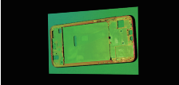
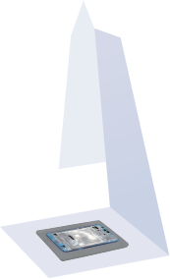
Professional 3D area scanner built for craftsmanship
Intelligent Hand-eye Expert
Core advantage
Ultra high precision
Self-developed machine vision high precision calibration algorithm, single point repeat accuracy up to 7 μ m.
Close range and depth of view
190 * 133 @ 600mm Field range of view 180mm depth of field, to meet the close large depth of field application.
Anti-interference
HDR dynamic point cloud synthesis technology to effectively handle the presence of both black and bright white at the same time.
Point cloud display
Golf ball head detection point cloud
The frame hole position in the mobile phone detects
point cloud
Cement block flatness detection point cloud
Product reference data
model | RVC-I5180
Minimum shooting time (sec / frame) | 1.93
Resolution (MP) | 5
Operating distance range (mm) | 420~600
Near Field of View (FOV) (mm) | 136*91 @ 420
Far Field of View (FOV) (mm) | 190*133 @ 600
XY direction resolution (mm) | 0.06~0.09
Z-axis single-point repetition accuracy (mm) | 0.007~0.015
Repeat accuracy of the Z-axis region (mm) | 0.0008~0.0012
illuminant source | blue LED
communication interface | Gigabit Ethernet
Camera weight (kg) | 1.5
Camera size (mm) | 220*135*57
Operating voltage / current | DC 24V/3.75A
Levels of protection | IP65
Operating temperature (°C) | 0~45
Operating Humidity (% RH) | 20~80 (no condensation)
Standard fitting | Power supply adapter, power supply cord, data cable
Whether the third-party development is supported | yes
Supported development language | C/C++/C#/Python
Supported development platform | Linux/Win dows
Adapt to the third-party software library | Halcon/OpenCV/Open3D/PCL/VisionPro
420mm
600mm
91mm
136mm
133mm
190mm
www.rvbust.com
400 - 0419 - 900
sales@rvbust.com

Slide 14
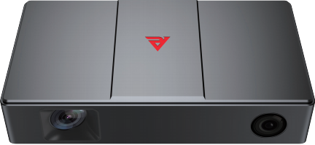
Professional 3D area scanner built for craftsmanship
Intelligent Hand-eye Expert
RVC-I3360
High-precision
3D Area Scanner
RVC-I3360 high-precision 3D area scanner is suitable for close range shooting with high precision and anti-reflective features, which can quickly shoot automotive sheet metal parts, all kinds of assemblies, and other complex surface objects with a certain degree of reflective, dark-colored objects. It can output high-precision 3D point cloud data, which is suitable for dimensional inspection process scenarios after three-dimensional reconstruction.
Aviation aluminum integrated fuselage provides comprehensive protection
Waterproof level greatly improved
Dust proof level greatly improved
Passed professional vibration test
USB 3.0 data transmission
Integrated Body
stable and solid
Fan-free heat dissipation Design
Weight loss, noise reduction, smaller volume
High brightness 3D Blu-ray module Stabilization of light output
To achieve a stable and reliable scanning
Equipped with high-resolution lens
High environmental resistance
performance fuselage
Reduce the image noise of point cloud
Aviation aluminum alloy shell
IP 65 class protection
www.rvbust.com
400 - 0419 - 900
sales@rvbust.com

Slide 15
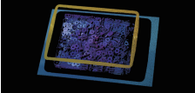
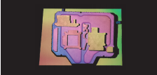
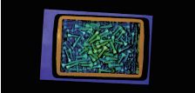
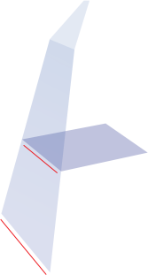
Professional 3D area scanner built for craftsmanship
Intelligent Hand-eye Expert
Core advantage
High-accuracy
Self-developed machine vision high precision calibration algorithm, single point repeat accuracy up to 7 μ m.
Anti-interference
HDR dynamic point cloud synthesis technology to effectively handle the presence of both black and bright white at the same time.
Point cloud display
Randomly stacked shim
point cloud
3D structural reconstruction of metal castings
point cloud
Screws of different sizes
point cloud
Product reference data
model | RVC-I3360
Minimum shooting time (sec / frame) | 0.8
Resolution (MP) | 3.2
Operating distance range (mm) | 400~700
Near Field of View (FOV) (mm) | 244*177 @ 400
Far Field of View (FOV) (mm) | 413*301 @ 700
XY direction resolution (mm) | 0.13~0.21
Z-axis single-point repetition accuracy (mm) | 0.007~0.022
Repeat accuracy of the Z-axis region (mm) | 0.002~0.005
illuminant source | blue LED
Communication interface | USB3.0
Camera weight (kg) | 1.5
Camera size (mm) | 250*135*57
Operating voltage / current | DC 24V/3.75A
Levels of protection | IP65
Operating temperature (°C) | 0~45
Operating Humidity (% RH) | 20~80 (no condensation)
Standard fitting | Power supply adapter, power supply cord, data cable
Whether the third-party development is supported | yes
Supported development language | C/C++/C#/Python
Supported development platform | Linux/Win dows
Adapt to the third-party software library | Halcon/OpenCV/Open3D/PCL/VisionPro
400mm
700mm
177mm
244mm
301mm
413mm
www.rvbust.com
400 - 0419 - 900
sales@rvbust.com

Slide 16
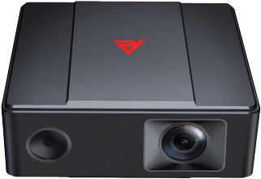
Professional 3D area scanner built for craftsmanship
Intelligent Hand-eye Expert
RVC-I2370
Lightweight
3D Area Scanner
The RVC-I2370 is a lightweight 3D area scanner that is small in size, light in weight, and flexible in dep-loyment. It is suitable for mounting on collaborative robotic arms, composite robots, or integrating into space-constrained inspection equipment to assist robots to better cope with high-precision vision posi-tioning and guidance applications, such as material transfer, disordered gripping, assembly, loading and unloading, welding, and parts sorting.
Aviation aluminum integrated fuselage provides comprehensive protection
Waterproof level greatly improved
Dust proof level greatly improved
Passed professional vibration test
Gigabit Ethernet port data transfer
Integrated Body
stable and solid
——————
——————
Fan-free heat dissipation Design
Weight loss, noise reduction, smaller volume
High brightness white light projection Stabilization of light output
To achieve a stable and reliable scanning
High environmental resistance
performance fuselage
Equipped with high-resolution lens
Aviation aluminum alloy shell
Reduce the image noise of point cloud
IP 65 class protection
www.rvbust.com
400 - 0419 - 900
sales@rvbust.com

Slide 17
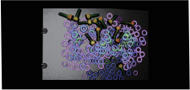
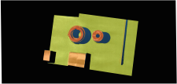
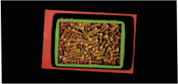
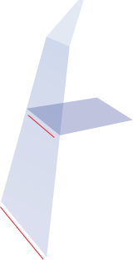
Professional 3D area scanner built for craftsmanship
Intelligent Hand-eye Expert
Core advantage
Light and small
The body size is only 150 * 135 * 57mm; the weight is only 0.87kg for lightweight industrial robots.
Ultra high precision
Self-developed machine vision high precision calibration algorithm, single point repetition accuracy up to 0.047mm.
Fast shooting speed
Self-developed accelerated hardware and point cloud production algorithm, which can reach the second-level imaging speed.
Point cloud display
Randomly stacked shim
point cloud
A variety of different items
point cloud
Screws of different sizes
point cloud
Product reference data
model | RVC-I2370
Minimum shooting time (sec / frame) | 0.83
Resolution (MP) | 1.6
Operating distance range (mm) | 400~800
Near Field of View (FOV) (mm) | 248*164 @ 400
Far Field of View (FOV) (mm) | 500*331 @ 800
XY direction resolution (mm) | 0.17~0.34
Z-axis single-point repetition accuracy (mm) | 0.047~0.140
Repeat accuracy of the Z-axis region (mm) | 0.005~0.018
illuminant source | RGB LED
Communication interface | Gigabit Ethernet
Camera weight (kg) | 1.15
Camera size (mm) | 150*135*57
Operating voltage / current | DC 24V/3.75A
Levels of protection | IP65
Operating temperature (°C) | 0~45
Operating Humidity (% RH) | 20~80 (no condensation)
Standard fitting | Power supply adapter, power supply cord, data cable
Whether the third-party development is supported | yes
Supported development language | C/C++/C#/Python
Supported development platform | Linux/Win dows
Adapt to the third-party software library | Halcon/OpenCV/Open3D/PCL/VisionPro
400mm
164mm
248mm
800mm
331mm
500mm
www.rvbust.com
400 - 0419 - 900
sales@rvbust.com

